Slide 1

Crop Production Analysis
NAME: JANVI BANGAR
ID: STU65d788d1df1ec1708624081

Slide 2

PROBLEM STATEMENT
The agricultural sector plays a vital role in the economy of many countries, including India. Accurate prediction of crop production is essential for planning agricultural activities, managing resources, and ensuring food security. However, predicting crop production can be challenging due to various factors such as weather conditions, soil quality, and agricultural practices.

Slide 3
Project Description
The objective of this project is to develop a predictive model that can forecast crop production in different states and districts for various crops and seasons Utilizing historical data on crop types, areas, and production quantities. The model aids stakeholders in making informed decisions for agricultural planning, resource allocation, and market forecasting, contributing to food security and economic growth.

Slide 4

WHO ARE THE END USERS?
This model can assist :
farmers, government agencies, and agricultural experts in making data-driven decisions to optimize agricultural productivity and ensure food security.

Slide 5

Technology Used
Power BI Desktop
Power Query Editor
Microsoft PowerPoint

Slide 6
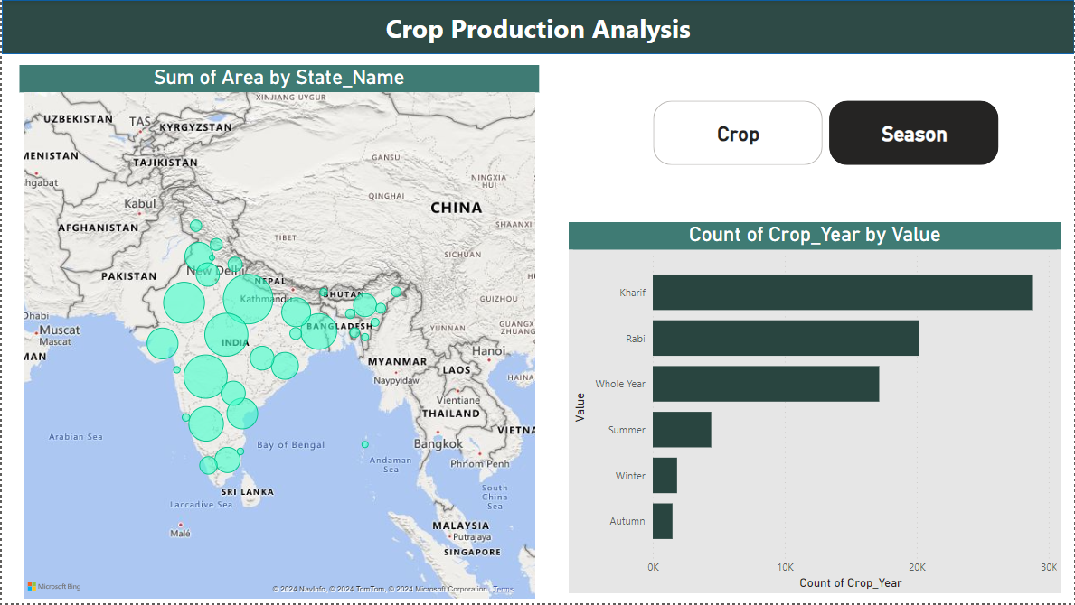
RESULTS
PROJECT LINK:

Slide 7
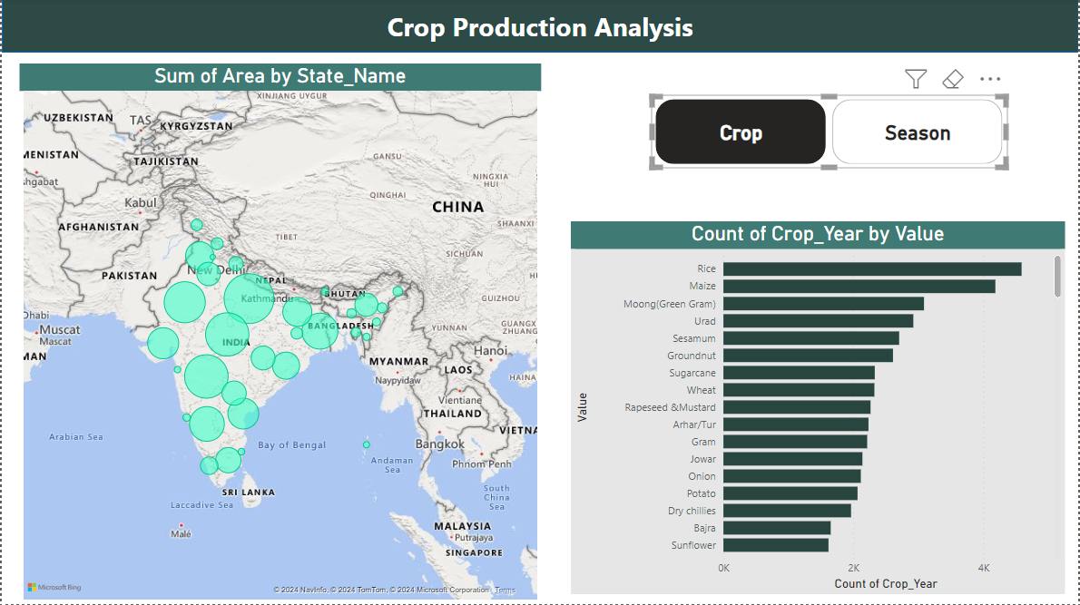
RESULTS
PROJECT LINK:

Slide 8
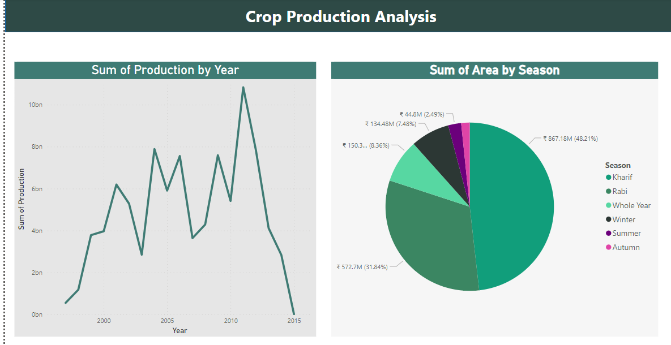
RESULTS
PROJECT LINK:

Slide 9
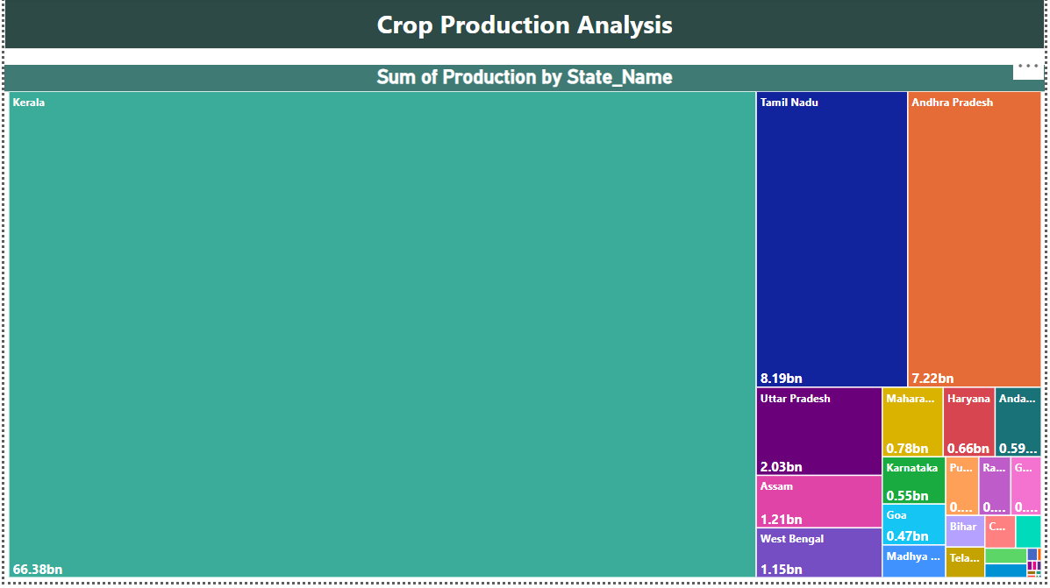
RESULTS
PROJECT LINK:

Slide 10
Thank you
PROJECT LINK:
.
.

